Slide 1

Used Vehicle Market Analysis
CIS412 Project
by
Garrett Power

Slide 2
Table of Contents
Business Understanding
Data Understanding
Data Preparation
Predictive Model
Model Evaluation
Model Deployment
Used Vehicle “Cheat Sheet”

Slide 3

Business Understanding

Slide 4
Business Problem:
In the used vehicle market, the inconsistent valuation across private sellers and manufacturers result in market trends that can be quite difficult for the average person to gain any helpful insight when deciding to purchase a vehicle.
How this analysis aims to help:
By analyzing historical sales data for used vehicles and utilizing some machine learning methods, the goal is to reliably predict the fair value of vehicles commonly found to be sold in the market.
Then we can investigate the data and results of the machine learning method in hopes of aiding potential buyers with their next used vehicle purchase.

Slide 5
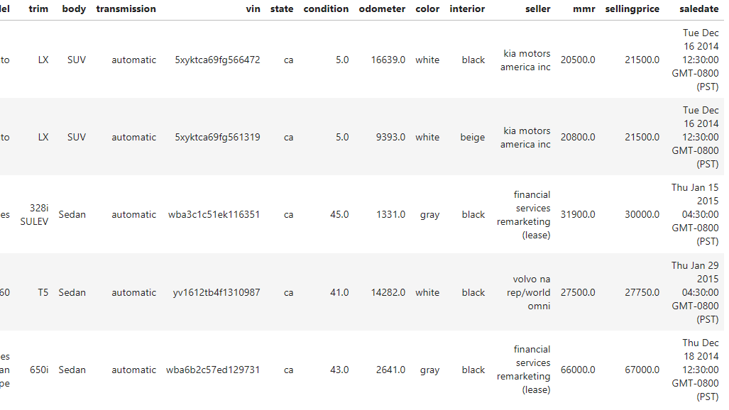
Data Understanding

Slide 6
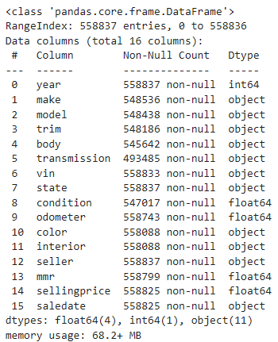
Dataset: https://www.kaggle.com/datasets/syedanwarafridi/vehicle-sales-data/data How this data will address the Problem: Historical data like this has been proven to have the ability of providing insight into real market behaviors, especially when utilizing variables such as Manheim Market Report (MMR) value to later label a sale as underpriced or overpriced.

Slide 7
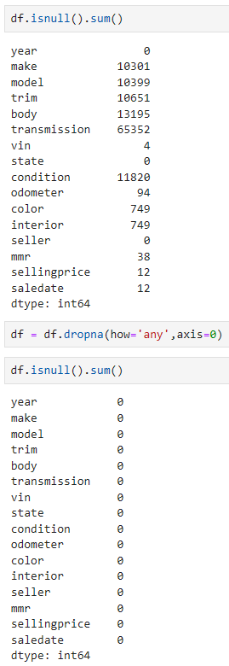
Variables:
Vehicle year (1990-2015)
Vehicle make
Vehicle model
Model trim
Vehicle body type
Vehicle transmission type
VIN (Vehicle Identification Number)
Vehicle state of registration
Vehicle condition rating
Vehicle odometer reading (mileage)
Vehicle exterior and interior colors
Seller information
Manheim Market Report (MMR) values
Vehicle sale dates
Vehicle selling prices
Many nulls were included in the source data that were removed during preprocessing, and there weren’t any extreme outliers in variable ranges.
The categorical features had anywhere from two (transmission), hundreds (model), and thousands (VIN) of classes, requiring the need for encoding.

Slide 8

Data Preparation

Slide 9
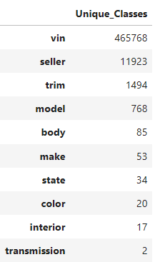
Feature Engineering:
Added vehicle age variable
Converted time-related variables to correct datetime format
Scaling numerical variables with StandardScaler
OneHotEncode categorical variables
Nulls have been addressed
Dropped VIN and seller info as unnecessary features
As described earlier, it’s important to be careful when handling these kinds of variables with the potential for having many unique classes before conducting any machine learning methods

Slide 10

Predictive Model

Slide 11
Random Forest Regressor
Target variable: selling price
Training/Test split size: 80:20
Specifics:
Scikit-learn ‘Pipeline’ to train and evaluate a random forest regressor model
StandardScaler and OneHotEncode data transformers
GridSearchCV parameter optimization and model cross-validation
Evaluation metrics MAE, RMSE, and R^2

Slide 12

Model Evaluation

Slide 13
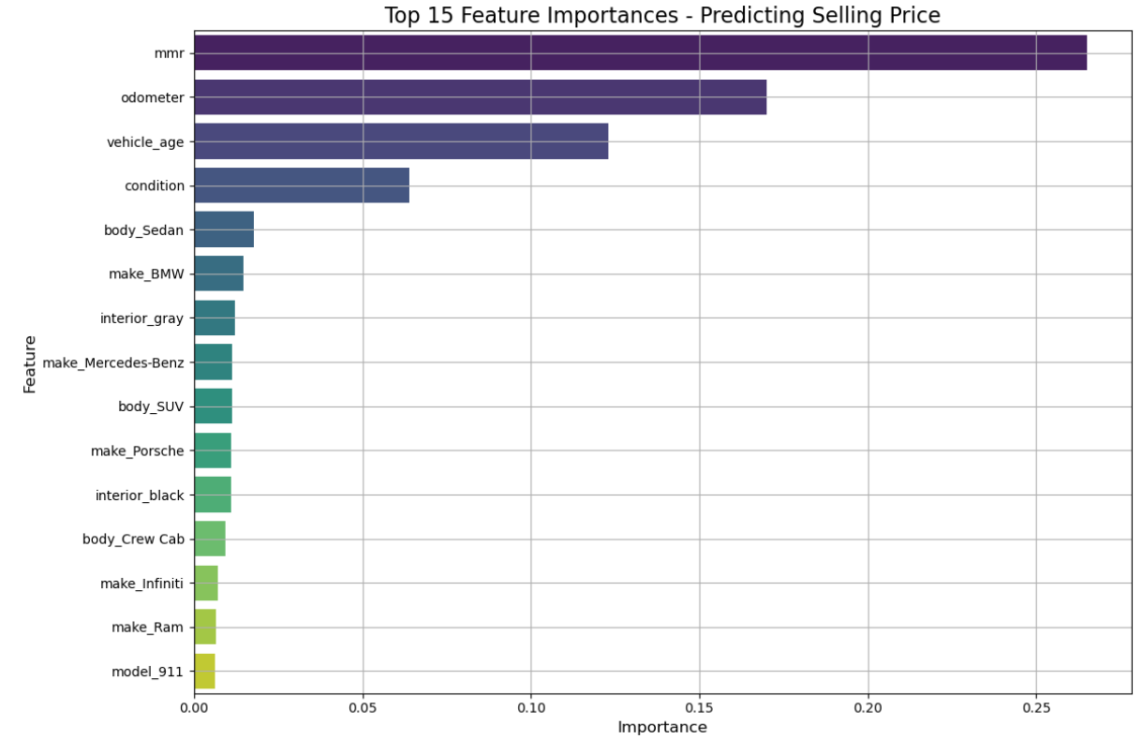
Evaluation Results and Best Parameters:
The model tended to underestimate the value of all vehicles
The model found features like MMR to be the most important when predicting selling price, along with other also-typical choices such as mileage reading and the vehicle condition
Selling prices are heavily right-skewed in distribution (less expensive vehicles are more common)
Mapping market segments to the sales records in this dataset based on price distribution could allow us to gain some interesting insight into deals on used vehicles based on an individual’s probable budget/segment

Slide 14
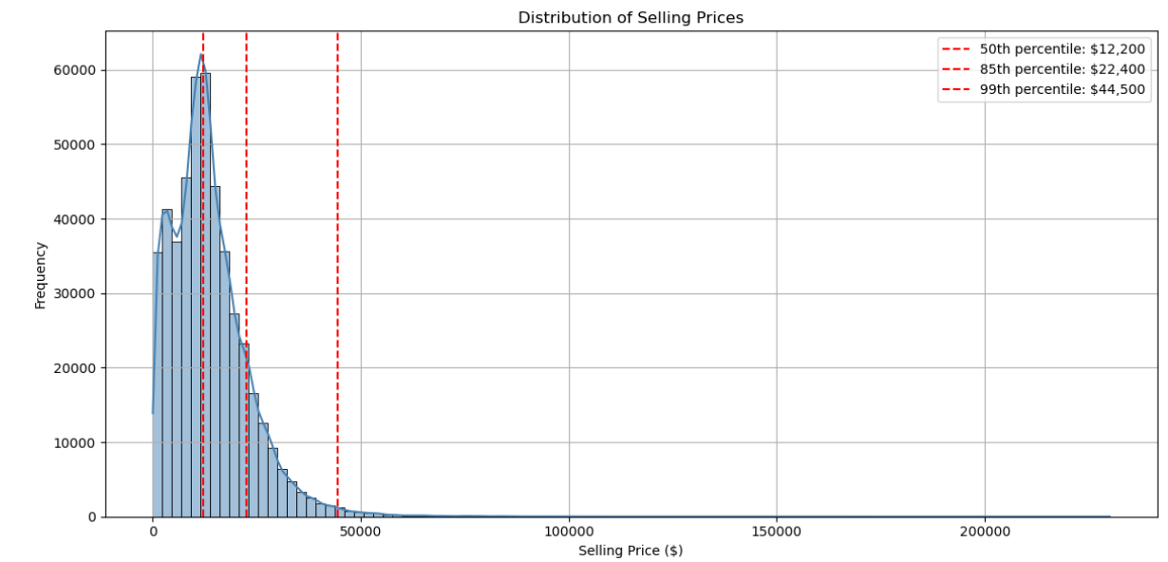
Over 99% of all records are valued at, or under, $44,500 despite the maximum value found in this dataset to be about $200,000
This skew in distribution gave me the idea to use market segmentation based on the selling prices, creating four total segments:
Economy
Mid-Range
Premium
Luxury

Slide 15

Model Deployment

Slide 16
The Random Forest model as it stands could be deployed as a free ML algorithm and hopefully be developed further to aid prospective buyers with predicting the fair price of a vehicle model that they may be interested in. After exploring the data and analyzing potential market segments, additional measures were taken to offer more tangible and immediate results for those looking to purchase a used vehicle (a major financial purchase and investment).
Discount column added that analyzed each sales record and produced:
Label ‘1’ for whether the sale price was below the MMR value (discounted)
Label ‘0’ for the sale price being over the MMR value (no discount)
Average Offer column added that calculated whether that vehicle model (by year) was found to be sold under or over the MMR value on average
Created a Used Car ‘Cheat Sheet’ to be released that uses this Average Offer column to display the most popular models of each year (1990-2015), and whether that vehicle is likely to be found for sale at a fair price

Slide 17
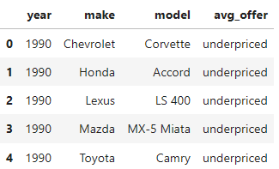
Used Vehicle “Cheat Sheet”
The free Used Vehicle “Cheat Sheet” for prospective buyers that is also to be released!
Featuring the most popular used vehicles from 1990-2015 and a reference label for whether that model is commonly sold over or under a fairer price, based on the vehicle MMR.
This example displays the 5 most popular used vehicle models from the year 1990 in this data, with their corresponding average offer classification

